Slide 1
IEEE Central Texas Section 2019 SPRING Planning Meeting January 19, 2019 San Marcos, TX
Section Committee/Officer Name: Amritesh Rai
Chapter/Affinity Name: TEMS Graduate Students (CH05250 - Central Texas Section Chapter, TEM14)
Prepared by: Amritesh Rai

Slide 2
Mission and Leadership Team
Mission/2019 Focused Initiatives*
Organize technical meetings (4), workshops (2) and social/networking events (4) on UT Austin campus
Chapter just became a Registered Student organization (RSO) with UT Student Activities → can now officially hold events anywhere on UT campus! Next step is getting registered as a Sponsored Student Organization (SSO) with UT ECE dept.
Faculty Advisor: Dr. Deji Akinwande
Collaborate closely with the CTS YP Group and seek additional funding (through YP funding portal as well as Corporate funding!)
Leadership Team
Position Name Email
Chair Amritesh Rai amritesh557@ieee.org
Vice Chair Rachel S. Rajarathnam rachelselina.r@utexas.edu
Secretary Subrahmanya Teja subrahmanya_teja@utexas.edu
Webmaster/vTools Vignesh Radhakrishnan vigneshr@utexas.edu
Corporate/Academic Liaison Jacob Rohan jacobnrohan@gmail.com
(*) These can be technical meetings, workshops, networking events, etc.

Slide 3
2018 Key Accomplishments
Meetings (month, topic, L31):
Leadership Reading Group meeting (March 2018, “Leadership Strategy”)
Leadership Reading Group meeting (April & May 2018, “Ethics”)
IEEE Day Networking Social (October 2018, in collaboration with CTS YP AG)
Note: TEMS Graduate Chapter was instated early 2018. Took a long while to get officially registered as a student organization at UT as well as to recruit IEEE graduate student officers! Moreover, my absence over the summer slowed down the progress. However, we’re finally on track now!

Slide 4
2018 Chapter Vitality & Help Needed
Chapter Vitality Assessment (Strong, Ok, Need Improvement)
Examples: Attendance, Topical & Relevance, membership recruitment, finance, volunteers, ….
Needs improvement!
Need to organize more events (technical + non-technical) on UT campus for students, staff and faculty
Engage and recruit more graduate student volunteers
Will generate more funding through corporate and YP sponsorships
Top Help Needed/Issues
Examples: Attendance, Speakers, Training, Finance, Events, collaboration with STEM/Students/PACE/YP/Life Mem, …
Corporate speakers
Officer training
Collaboration with CTS undergraduate students and YPs
Finance!!! (submitted first ever financial plan only this year since TEMS Graduate Chapter only recently formed)

Slide 5
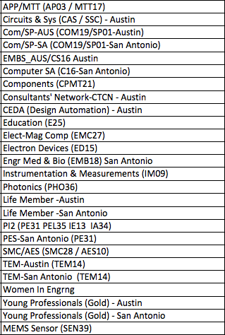
CTS Leadership
CTS Officers
Chapters/Affinity
Standing Committees/Coordinators
Chair
Fawzi Behmann
Vice Chair – A
Fabio Gomez
Vice Chair – SA
Ehsaneh Sunny Shahhaidar
Secretary
Raymond Choo
Treasurer
Bill Martino
Past Chair
Leslie Martinich
Past Past Chairs
Kenny Rice
Strategic Plan
Policies and Procedures PARP
Awards and Recognition
Membership Development
Electronics Communications
Website
vTools
Communications Portal
Conferences/Events
Section-Chapter Vitality Chair
Finance
K-12/STEM Educational Activities
Students Activities
Professional Activities – PACE
Outreach Program
Humanitarian

